Slide 1
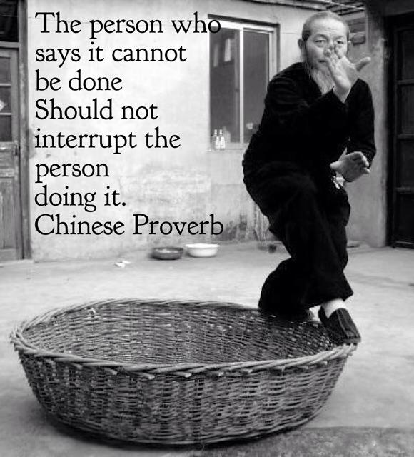
Impact of Mindfulness Training on the Stress Resiliency & Wellness among People in Recovery: Mindful Eating
A Pilot Study
Dori Hutchinson, Sc.D, CPRP
Center for Psychiatric Rehabilitation
Boston University
October 17, 2014

Slide 2
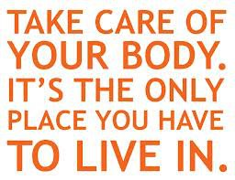
Conceptual, Research and Practical Issues in Using a Mindfulness Approach to Eating Well
Dieting /commercial weight loss programs are often not an enduring approach to eating well. They entais a disengagement from the use of internal cues of hunger and satiety.
Stress is related to nutritional behavior. It is important to intervene in this health domain as people with mental health conditions often have issues with food related diseases as well as eating habits that are triggered by stress, poverty and negative emotions.
Mindfulness is a nonjudgmental awareness of the present moment. Buddhism roots.

Slide 3

Mindful Eating, Mindful Life
Mindfulness techniques reduce stress, alleviate health problems.
Mindful eating helps people recognize differences between emotional and physical hunger and introduces a “ moment of choice” between the urge and eating.
NIH studies of mindful eating for treatment of eating disorders.
  (Harvard Health Letter, 2011)

Slide 4
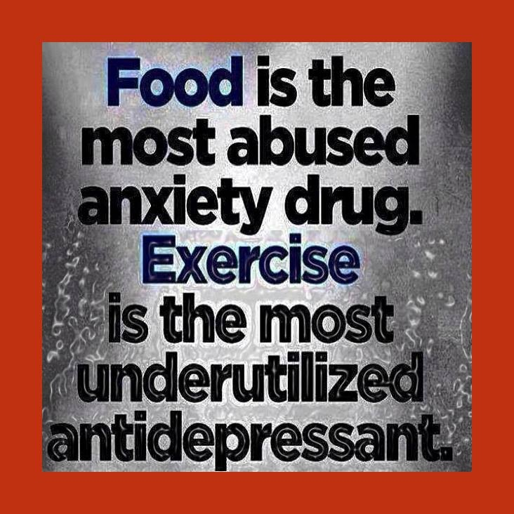
Conceptual, Research and Practical Issues
Mindfulness skills teach people to observe feelings, behaviors and experiences, to disengage automatic and often non- healthy reactivity, and to develop wiser and more balanced relationships with their selves, with their bodies and with food.
Making choices about food is an ever present part of daily life that has enormous health consequences for all people.
Because Mindfulness eating engenders awareness of WHY one eats, it is a helpful skill to lose weight and acts against MINDLESS eating.

Slide 5
Research and Practice
Prevalence of obesity in persons with mental illnesses has been reported to be as high as 55% (De Hert, et. al, 2009)
Significant medical consequences of obesity –type II diabetes, dyslipidemias, metabolic syndrome and hypertension. All these factors contribute to the nearly double risk of dying from cardiovascular disease.
SES, smoking, medications are contributing factors.
Modifying dietary behaviors through mindfulness hold promise as a health intervention as well as a generalized skill to promote stress resiliency and wellness.(Framson, et. al, 2009) .
Mindfulness is a learned skill that is linked in the research to many positive health outcomes (Brown, et. al, 2009; Framson, et al, 2009 Kabat-Zinn, et. al, 1992)

Slide 6

Process
Utilized a Supported Education Framework
12 weeks; 2 (1.5) hr sessions/week
Students encouraged to bring own food for the lunch based class.
Peer Instructors

Slide 7

Teaching/Facilitator Process
Review
Orientation
  Bell exercise
  Breath exercise
  Use of hunger scale
  Recite a meal time contemplations
  Silent eating with music
Skills Training
  Multimodal activities
  UDL principles employed
   PRACTICE
  HOMEWORK
    Tapes for Students to bring home

Slide 8
Curriculum Topics
Training the mind to be present and focused on what students are eating.
Eating Mindfully: Using a hunger scale.
Applying Moderation: Avoiding Extremes.
Distinguishing Emotional from Physical Hunger.
Applying Strategies to overcome emotional hunger and unwanted habits.
Developing Stress Hardiness and Patience with Old Eating Habits.
Practicing Self-Acceptance, Self-Compassion, and Self-Forgivenss
Building Optimism.
Developing Gratitude for the Food We Eat.
Practicing Generosity through Sharing of Food with one Another.
Choosing Health and Recovery –Promoting Foods.
Increasing Personal Awareness.
Increasing Environmental Awareness.
Planning, Creating Shopping Lists and Preparing Meals.

Slide 9
Demographic Summary

Slide 10
Primary Psychiatric Diagnosis

Slide 11
Medical Conditions
12 of 18 students (66.7%) reported having a medical condition
Most common medical conditions:

Slide 12
Mindful Eating Questionnaire
Five Subscales:
  Awareness
  Distraction
  Disinhibition
  Emotional Response
  External Cues
Total Score is also calculated
Higher scores indicate student progress

Slide 13
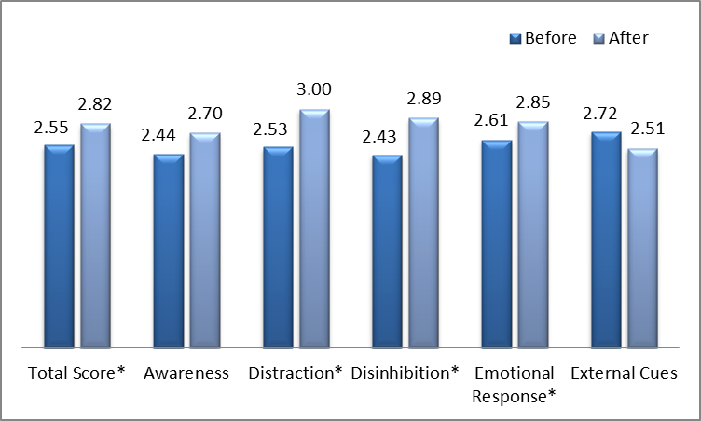
Mindful Eating Questionnaire:
Mean Scores Before and After
*Indicates p-values <0.05

Slide 14
Three Factor Eating Questionnaire
Three Factors:
  Cognitive Restraint
  Uncontrolled Eating
  Emotional Eating
Cognitive Restraint: Higher scores indicate student progress
Uncontrolled Eating and Emotional Eating: Lower scores indicate student progress

Slide 15
Three-Factor Eating Questionnaire
Cognitive Restraint: Mean Scores Before and After
p-value <0.05

Slide 16
Three-Factor Eating Questionnaire
Mean Scores Before and After
Uncontrolled Eating
Emotional Eating
p-values <0.05 for both

Slide 17

Future Directions
Scaling Up: Manualizing the curriculum; Implementing a larger study with broader investigation on health related factors.
dorih@bu.edu

