Slide 1
UIC State of the Science Integrated Health Conference
October 17, 2014
Implementing a Diabetes Registry and
Care Coordination in Community Mental and Physical Health Clinics
Jessica A. Jonikas, M.A., Crystal M. Glover, Ph.D., & Judith A. Cook, Ph.D.

Slide 2
Today’s Presentation
Diabetes as a public health crisis
UIC Diabetes Care Coordination & Registry Study
The case for registries: benefits and evidence
Using a registry to support population management and self-management
Preliminary results from our study
Considering key barriers
Reflections on next steps

Slide 3
With thanks to our funders
U.S. Department of Education, National Institute on Disability & Rehabilitation Research
Substance Abuse & Mental Health Services Administration, Center for Mental Health Services
Cooperative Agreement #H133G100028

Slide 4
Registry & Care Coordination Collaborators
UIC Center on Psychiatric Disability & Co-Occurring Medical Conditions
UIC College of Nursing, Integrated Health Care Clinics
Thresholds Psychiatric Rehabilitation Centers
UIC Eye & Ear Infirmary & Dr. LaVallee
Kennedy-King College’s Dental Hygiene Department
Dr. Robert Laveau at UIC Podiatry Clinic

Slide 5
Key Study Partners
Sue Braun
Emily Brigell
Kathy Christiansen
Kristin Davis
Katy Dobbins
Jay Forman
Ann Heesacker
Asma Jami
Sheila O’Neill
Deborah Pavick
Pam Steigman
Joni Weidenaar

Slide 6
A Public Health Crisis
People in recovery have a higher prevalence of diabetes:
Lifestyle factors
Psychiatric medications that cause blood sugar disorders
Complicated illness
- doctors & patients often unsure of what’s behind poorly controlled glucose
People with diabetes are at-risk for developing:
Hypertension
Hyperlipidemia
Heart disease
Kidney disease
Gum disease/loss of teeth
Nerve damage/loss of feet
Eye disease/becoming blind
Costs are 2.4 times greater; nearly 40% of costs due to long-term complications.

Slide 7
Use of a Registry to Manage Care for Diabetes in Integrated Health Clinics for Adults with Serious Mental Illnesses
Judith A. Cook, PhD, Principal Investigator
Introduce a diabetes registry to:
Improve care delivery
full adherence to ADA standards of care
develop new treatment & service resources
Enrich care coordination
link clients to needed specialty care in accordance with ADA standards
teach clients about diabetes and its complications
Better monitor health indicators and outcomes over time
Free Diabetes Toolkit
http://www.cmhsrp.uic.edu/health/diabetes-library-home.asp

Slide 8
What is a Diabetes Registry?
Database with demographics, illness characteristics, treatment delivered, and specialty care arranged/delivered
Information from electronic and paper records guides care, tracks outcomes, and informs plans for improving care
Supports proactive care by facilitating care planning, sharing of information with other providers, and generating patient reminders
Generates charts and graphs to support illness self-management
Generates reports to monitor team and system performance
Overall goal is to improve adherence to treatment guidelines and self-management

Slide 9
Sample Standards Tracked in Diabetes Registries for Individual & Population Management
Standard | Target
Blood Glucose Control (HbA1c) | Less than 7%
Blood Pressure | Less Than 140/90 mmHg
LDL cholesterol | Less Than 100 mg/dl
Urine Screening for Microalbumin | Annual screening
Dilated eye exam | Annual screening
Foot exam for neuropathy | Annual screening
Dental exam | Annual screening
Vaccinations | Lifetime and annual

Slide 10
How are data entered?
Different options depending on resources:
Clinicians enter data manually themselves during or after visits
Clinicians complete diabetes encounter forms, which are sent to a central site for data entry that is supported by a registry project
Care coordinators obtain information for the registry from patient records after each visit
Clinicians complete diabetes encounter forms, which are given to the Care Coordinator to enter into the registry

Slide 11
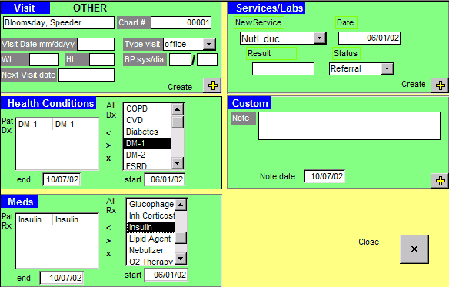
Why Registries for Standards of Care?
One electronic database contains data from multiple sources to inform complex disease processes
Quickly focuses effort on better managing chronic disease at population level
Can be used by multiple parties (clinicians, patients, administrators) to facilitate care delivery while meeting care standards
(Ortiz, 2006)

Slide 12
Registries and Patient-Centered Care
Allows clients to see their test results related to 1 or more conditions all in one place
Permits clients to share current results with specialists and other providers for safer/better care coordination and outcomes
Helps clients track their own results over time, assess personal improvements, and identify areas of concern
Enables clients to compare their test results and health outcomes with those of peers or the general population

Slide 13
Why Registries for Care Coordination?
Allows for identification and monitoring of clients with a specific need within a clinic or across clinics
Fosters individual disease management through notifications of abnormal test results, missed appointments, and up-to-date information on client encounters
Promotes use of evidence-based and values-driven care
Puts the focus on the needs and progress of high-risk clients to manage limited resources (client & clinic)
Facilitates health outcomes management at both the individual and clinic levels
(Hummel, 2000)

Slide 14
Population Studies using a Diabetes Registry
Improving Diabetes Care in a Large Health Care System:
An Enhanced Primary Care Approach
Sperl-Hillen, et al. (2000). Joint Commission Journal on Quality and Patient Safety
Improved glycemic and lipid control among approximately 7,000 adults with diabetes.
The Impact of Planned Care and a Diabetes Electronic Management System on Community-Based Diabetes Care:
The Mayo Health System Diabetes Translation Project
Montori et al. (2002). Diabetes Care.
Registry use augmented the impact of planned care on performance outcomes (increased use of specialty medical care) and certain metabolic outcomes. Did not impact glucose levels.

Slide 15
Diabetes Registries: Across Clinics
Improving Diabetes Outcomes Using a Web-Based Registry and Interactive Education: A Multisite Collaborative Approach
Morrow, R. et al., (2013). Journal of Continuing Education in the Health Professions
Electronic diabetes registry in 7 clinics in NY
With educational module on the registry and patient communication
With each quarter post-Registry, patients were:
1.4 times more likely to have A1C ≤ 9
Almost twice as likely to have LDL < 100
1.3 times more likely to have BP < 140/90
Likelihood of adherence increased over the initial quarters (except for BP; adherence dipped over time). There was a drop-off among all indicators after 5 quarters, suggesting ongoing support and training are needed

Slide 16
Okay, but why not just use an Electronic Health Record?
Most EHRs are not built to function as registries, so can’t support population-based care
It can take years for population reporting from an EHR
A registry is relatively easy and inexpensive
Can have nearly immediate impact on clinic practice and client engagement & outcomes
It can be instructive to learn population-based care parameters prior to implementing an EHR via a registry
Allows you to design EHR processes to support needs identified by registry use
Content adapted from:
www.powershow.com/view/21d14-MzEyZ/Using_Excel_for_a_HgA1c_Registry_powerpoint_ppt_presentation

Slide 17
Platform Options
CareMeasures
www.caremeasures.org/CareMeasures/public/Default.aspx
Easy to use & customize
Manages multiple conditions
Must register & pay fees
Excel
http://www.aafp.org/fpm/2006/0400/p47.html
Free software and template
Easy to learn and implement
- Storing only the most
recent results
Good for population management of single disease
CDEMS cdems.com
Relational database
Challenging to learn and implement
Technical support no longer available
Doc Site portal.covisint.com/web/supporthc/ccahc
Web-based; easy to access
Can role up nationally
Annual per provider fee
Content adapted from:
www.powershow.com/view/21d14-MzEyZ/Using_Excel_for_a_HgA1c_Registry_powerpoint_ppt_presentation

Slide 18
www.aafp.org/fpm/2006/0400/p47.html

Slide 19
Population Management via Reports
Client Last Name | Client Birthdate | Provider | Value of most recent A1C | Date of most recent A1C
Ryan | 03/31/40 |  | 9.8 | 09/05/2014
Bell | 05/25/72 |  | 8.9 | 02/18/2013
Cruz | 06/16/60 |  | 7.8 | 06/17/2013
Smith | 01/15/65 |  | 7.1 | 08/15/2014
Ramirez | 05/24/61 |  | 6.5 | 08/01/2013
Jordan | 09/12/60 |  | 6.5 | 09/12/2013
Stock | 10/10/80 |  | 6.2 | 07/13/2014
Blake | 12/12/40 |  | 5.2 | 05/14/2014
Bergman | 11/12/61 |  | 5.0 | 05/05/2014
Sort by test value to determine who is most at risk
Registry Reports from a Simple Microsoft Excel-based Registry

Slide 20
Care Coordination via Reports
Client Last Name | Client Birthdate | Provider | Date of most recent eye exam
Bell | 05/25/72 |  | 11/11/2011
Cruz | 06/16/60 |  | 06/10/2012
Ramirez | 05/24/61 |  | 04/15/2013
Jordan | 09/12/60 |  | 02/17/2013
Smith | 01/15/65 |  | 10/16/2013
Ryan | 03/31/40 |  | 10/17/2013
Stock | 10/10/80 |  | 04/13/2014
Bergman | 11/12/61 |  | 03/05/2014
Blake | 12/12/40 |  | 02/14/2014
Sort by test date to determine who is overdue and needs care coordination
Registry Reports from a Simple Microsoft Excel-based Registry

Slide 21
Performance Management via Reports
Client Last Name | Client Birthdate | Provider | Value of most recent A1C | Date of most recent A1C
Ryan | 03/31/40 | Dr. S | 9.8 | 09/05/2013
Smith | 01/15/65 | Dr. S | 7.1 | 08/15/2014
Ramirez | 05/24/61 | Dr. S | 6.5 | 08/14/2014
Jordan | 09/12/60 | Dr. S | 6.5 | 08/17/2014
Bell | 05/25/72 | Dr. A | 8.9 | 02/18/2014
Cruz | 06/16/60 | Dr. A | 7.8 | 06/17/2013
Stock | 10/10/80 | Dr. A | 6.2 | 08/17/2014
Blake | 12/12/40 | Dr. A | 5.2 | 09/14/2014
Bergman | 11/12/61 | Dr. A | 5.0 | 09/05/2014
Sort by provider then value to identify performance goals
Registry Reports from a Simple Microsoft Excel-based Registry

Slide 22
The Purpose of Our Registry
Introduced to:
Fully adhere to ADA standards of care by improving care delivery and coordination
Link participants to specialty care in accordance with ADA standards
Teach participants about diabetes and its complications
Develop new treatment/service resources
Monitor health indicators and outcomes over time

Slide 23
The Collaboration
UIC College of Nursing staff operate the nurse-managed Integrated Health Clinics (IHCs) where study participants received medical care. At the time the initial study sample was drawn, the IHCs were serving 220 patients with co-occurring diabetes & mental illness.
Thresholds houses one IHC on Chicago’s north-side and one on Chicago’s south-side. Thresholds provided community support and linkage to Registry clients to help them attend the IHCs and specialty appointments, and to self-manage their co-occurring conditions.
UIC Center on Psychiatric Disability and Co-Occurring Medical Conditions staff built the registry which was populated with data on the 220 patients; the UIC Center funded the study’s Care Coordinator who liaisoned with IHC and Thresholds staff, focusing specifically on increasing adherence to diabetes care standards.

Slide 24
A Tour of our Registry
Chronic Disease Electronic Management System (CDEMS) platform
A relational database with demographic information, illness characteristics, treatment delivered, and specialty care arranged and delivered
Baseline data derived from 2011 IHC visits, with updates made each time a patient received treatment, including nurse visits, laboratory work, patient education, and/or specialty care
Generated patient- and clinic-level reports
Reports allowed for tracking of clinic-wide adherence to American Diabetes Association standards of care, as well as monitoring patients’ diabetes-related needs and outcomes

Slide 25
Registry & Coordination Procedures to Impact on Outcomes
Patient-specific reports from the registry were provided to nurses prior to each patient visit
helped orient them to the most recent treatment(s), upcoming tests or appointments, and the most pressing concerns
Patient education was chosen from comprehensive materials to address each patient’s specific needs and strengths at each visit
Patient education materials were also shared with community support workers to reinforce this learning in the community
Specialty care needs were identified for each patient
Support given for each client to see specialists, in accordance with the ADA standards of care (including optometrist, dentist, and podiatrist)

Slide 26
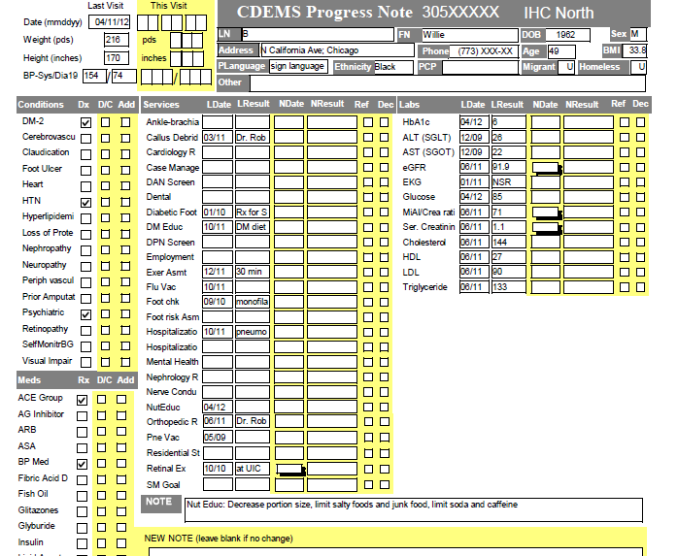
Sample Patient Specific Registry Report

Slide 27
Sample Patient Report Designed for Education &
Self-Management

Slide 28
Sample Patient Education

Slide 29
Registry Study Sample (n = 217)
67% male
2/3 members of racial/ethnic groups:
60% African American; 27% White; 4% Hispanic/Latino; 2% Asian; 7% Other
Age range: 20 to 77 years (mean=51; sd.=10)
54% were patients at the north-side clinic
46% were patients at the south-side clinic

Slide 30
Preliminary Medical Outcomes
Changes in glucose management following introduction of the Registry and Care Coordination:
The least controlled (i.e., poorest) A1c level during the pre-test years of 2010-2012 (N=205) averaged 7.97 per patient
A1c at the most recent visit during the post-test years of 2013-2014 (N=201) averaged 6.93 per patient
In other words, there was significant improvement from poorest to most recent A1c, decreasing by 1 point on average (t=5.08, p<.001).
Every 1% improvement in A1c is associated with a 25% decrease in a combined index of cardiovascular complications for people with type 2 diabetes (UK Prospective Diabetes Study Group, 1998).

Slide 31
Preliminary Medical Outcomes
Changes in total cholesterol and triglycerides following introduction of the Registry and Care Coordination:
Worst total cholesterol (TC) during the pre-test years (N=197) averaged 180 mg/dL per patient, while the average at post-test was 165 mg/dL (N=170) (t=3.5, p<.001)
Worst triglycerides level in pre-test years averaged 165 mg/dL per patient (n=198), while the average at post-test was 143 mg/dL (N=169) (t=2.2, p<.05)
The average TC and triglycerides showed significant improvement, with lipids and triglycerides dropping by 27 or more points.

Slide 32
Preliminary Specialty Care Outcomes
Changes in adherence to the ADA standards of care following introduction of the Registry and Care Coordination:
Between 2010-2012, completed dental referrals had a percentage increase of 500%
2.8% at pre-test, 16.6% at post-test (χ2 = 23.74, p < 0.001)
Between 2010-2012, completed optometry referrals had a percentage increase of 65%
21% at pre-test, 35% at post-test (χ2 = 10.1, p < 0.01)
Between 2010-2012, completed podiatry referrals had a percentage increase of 88%
15% at pre-test, 28% at post-test (χ2 = 11.3, p < 0.01)

Slide 33
Key Barriers to Registry Use
Shifting from reaction to prevention
Moving from individual level to population-based care
Getting multiple partners invested
Time to load and maintain the spreadsheet or database
Measuring performance can be threatening
Just another fad?
Content adapted from:
www.powershow.com/view/21d14- MzEyZ/Using_Excel_for_a_HgA1c_Registry_powerpoint_ppt_presentation

Slide 34
Reflections and Next Steps
Registries, especially those in a simple Excel format, can quickly focus attention on the needs of those clients who most require integrated and coordinated care efforts
The role of the behavioral health case manager/support worker is expanding to require expertise in medical management and medical care coordination
Integrated patient education, health literacy, and self-management are critical promotion and prevention approaches
Front-line and supervisory staff also benefit from employee health and wellness programs

Slide 35
Learn about our registry study www.cmhsrp.uic.edu/health/medical_home_registry.asp
Free Diabetes Toolkit
http://www.cmhsrp.uic.edu/health/diabetes-library-home.asp

