Slide 1

Incentives to Wellness
Dena Stoner
Texas Department of State Health Services
dena.stoner@dshs.state.tx.us
Sam Shore
Triwest Group
sshore@triwestgroup.net

Slide 2
What is MIPCD?
Medicaid Incentives for Prevention of Chronic Disease (Sec 4108 ACA)
Competitive five year federal grant opportunity from Centers for Medicare and Medicaid Services (CMS). No state match required.
Funds demonstration projects that use evidence-based incentives to help Medicaid clients adopt healthy behaviors, improve outcomes
Projects must address at least one of the following goals:
  tobacco cessation,
  controlling or reducing weight,
  lowering cholesterol,
  lowering blood pressure, or
  avoiding onset of diabetes or improving management of diabetes.
2
2
2
2
Notes:
Big study, like MN
Short intervention period
Only state / local partnership model in DMIE

Slide 3
MIPCD State Projects
STATE | TOBACCO CESSATION | WEIGHT LOSS | LOWERING CHOLESTEROL | LOWERING BLOOD PRESSURE | DIABETES MANAGEMENT OR PREVENTION
CA | X |  |  |  | X
CT | X
HI | X |  |  |  | X
MN |  | X |  |  | X
MO |  | X |  |  | X
NV |  | X | X | X | X
NH | X | X
NY | X |  |  | X | X
TX | X | X | X | X | X
WI | X
3
3
3
3
Notes:
Big study, like MN
Short intervention period
Only state / local partnership model in DMIE

Slide 4


Wellness Incentives and Navigation (WIN)
Stoner

Slide 5

What is WIN?
Wellness Incentives and Navigation (WIN) – Texas’ MIPCD Project
$9.9 million grant
Medicaid & State Health Services partnership
Project imbedded in Medicaid delivery system
Randomized Controlled Trial in Harris Service Delivery Area for Medicaid Managed Care
Over 1,600 participants in intervention, control and comparison groups
5
5
5
5

Slide 6

Target Population
Medicaid Managed Care (STAR+PLUS) members, ages 21 – 55 who:
  Live in the Harris service delivery area (Harris, Austin, Waller, Fort Bend, Montgomery, Wharton, Brazoria, Galveston and Matagorda Counties)
  Are not receiving Medicare
  Have either –
    serious mental illness, OR
    behavioral + chronic health conditions
6
6
6
6

Slide 7
Why WIN?
Risk - People with behavioral health conditions are significantly more likely to suffer chronic physical disease, and to die at a younger age. (29 years earlier than other Texans.). Leading causes of death are heart disease, cancer and lung disease.
Cost – Behavioral health conditions contribute significantly to higher medical costs (9 percent of TX Medicaid initial admissions,; 27 percent of potentially preventable readmissions).
Opportunity Capitated managed care is Texas Medicaid’s dominant health care delivery system for adults with disabilities. Significant potential for large scale change, if successful.

Slide 8
WIN Approach
Person-centered: Individual defines goals with professional health navigators, who are trained in Motivational Interviewing (MI) techniques.
Flexible: wellness account to support specific health goals defined by the participant in the individual wellness plan. ($1150 / yr., administered through the health navigators).
Recovery-oriented: Wellness Recovery Action Planning (WRAP) to enable participants with better manage mental illness.

Slide 9
WIN Collaboration
Governor
STAR+PLUS MCOs
Navigation, Authorization
HHSC
Oversight
Federal Interface
Evaluator (ICHP)
Recruitment,
Evaluation,
Flexible fund administration,
Navigator Training
DSHS
Project Management
Technical Assistance
Advisory
(Stakeholder) Group
9

Slide 10
WIN Interventions
Person-centered wellness planning with professional health navigators, who are trained in Motivational Interviewing (MI) techniques.
Wellness Recovery Action Planning training (WRAP) to enable participants with more severe mental illnesses to take full advantage of wellness planning.
Flexible wellness account to support specific health goals defined by the participant in the individual wellness plan. ($1150 / yr., administered through the navigator)

Slide 11
Evidence: Flexible Accounts
Arkansas Cash and Counseling program: people less likely to fall, have respiratory infections, develop bed sores, or spend a night in hospital or a nursing home
New Jersey Cash and Counseling program: equally successful for people with SMI as for other people
Florida Self-Directed Care (SDC) program evaluation found that, in the year after entry, people with psychiatric disabilities showed significant increases in # days living in the community and significantly better global functioning compared to the year prior.
Texas Self-Directed Care RCT - achieved superior client outcomes for no greater service delivery expenditures than those in the traditional services. One of the largest expenditure categories was related to health & wellness.

Slide 12
Allowed Purchases: Examples
Devices that promote wellness goals (e.g., digital scale, BP monitor, mobile device and / or app for physical activity, etc.)
Transportation to wellness activities (e.g., support groups, gym, etc.)
Subscriptions or memberships to promote wellness (e.g., YMCA, fitness magazine)
Behavioral Interventions not currently covered by STAR+PLUS (e.g., relaxation, visualization, etc.)
Individual wellness education
Family-based Wellness Training and Interventions
Nutritional or Medical Food
Other items approved by the Harris Project Manager

Slide 13
WIN Design
Baseline and Yearly Assessments
HRA, cognitive, demographic
Comparison
Group (n=404)
Control Group
(n=629)
Intervention Group (n=630)
Quarterly requests for current contact information
Monthly requests for contact information
Monthly Phone Appointment
Quarterly In-Person Appointment
Review health goals, purchase requests
Review health goals, purchase requests, BP, weight
Assessment
Data Collected

Slide 14
Navigators
Work for the Medicaid HMO, part of team
Qualifications include empathy, style compatible with MI intervention
Extensive, on-going MI training from nationally recognized experts
WIN database and STAR+PLUS training
Average caseload of 60-70 intervention group WIN participants

Slide 15
Operations
Participants are contacted by phone once a month and seen at least quarterly face to face in community
Clinical management and health navigation tools on mobile devices (iPads). Two linked software packages:
  Clinical Conductor to track and manage caseload
  WIN Portal to conduct intake assessments, identify resources, set goals and strategies, monthly follow-up and annual reviews
Debit Card Services Through Bank of America overseen by University of Florida team

Slide 16
Assessment
A series of questions about health risks
  “Do you now smoke cigarettes every day, some days, or not at all?”
Answers to certain questions will trigger a health risk
Additional questions for data collection
  Demographic information
  Cognitive measures
At the end of the survey, a list of Health Risks appears. These provide the basis for the goal setting process.
Participants articulate wellness goals in their own words
Goals are reviewed and updated regularly

Slide 17
Technology Supports WIN
Two linked software packages:
  Clinical Conductor to track and manage caseload
  WIN Portal to conduct intake assessments, identify resources, set goals and strategies, monthly follow-up and annual reviews
Navigator signs in to the WIN Portal on iPad
Gives second iPad to participants to complete consent form and intake assessment

Slide 18
Indicators
Development and achievement of personal health goals
Improved health as measured by
  Changes in blood pressure
  Changes in weight and BMI
  HbA1c control
Improved health care use (e.g., reduced potentially preventable inpatient admissions, readmissions, and emergency dept. visits)
Better adherence to treatment such as:
  Initiation and maintenance of treatment for alcohol dependence
  Initiation and maintenance of treatment for depression
  Appropriate use of asthma medications
  Comprehensive diabetes care

Slide 19
Data Sources / Methods
Annual participant surveys
Medical record review
Review of medical claims/encounters
Navigator collected health metrics
Cognitive assessments
Assessment and wellness plan data

Slide 20
Demographics
Mean age 44, 62% Female
About two thirds have SMI (alone or in combination with physical and other behavioral health problems)
43% non-Hispanic Black; 21% Hispanic, 35% non-Hispanic White
77% divorced, never married or separated
Over 70 percent in the severe chronic clinical risk category
Significant % have cognitive impairment (testing in bottom half to bottom quartile)

Slide 21
Major Goals selected by WIN participants
Weight loss – 70% of participants reported needing to lose weight
  75% of this group reports making progress toward their weight loss goal
Eating habits – over 70% of participants report the need to limit fast food intake
  91% of this group reports making progress toward their goal of better eating habits
Sedentary – nearly 50% of participants report no participation in physical activities
  67% of this group reports making progress toward their goal of being less sedentary
Upcoming annual surveys, medical record review, and review of medical claims will provide comparative data to analyze goal progress

Slide 22
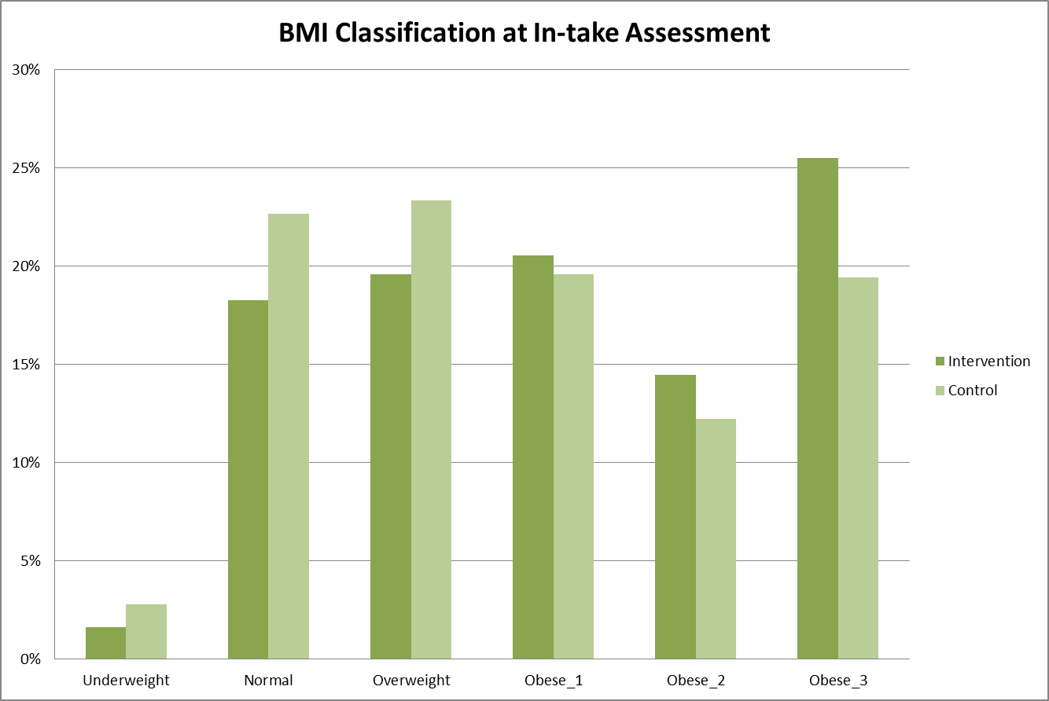
WIN Portal Data
BMI Classification
Classification | BMI Values
Under weight | <18.50
Normal | 18.50 – 24.99
Overweight | 25 – 29.99
Obese 1 | 30 – 34.99
Obese 2 | 35 – 39.99
Obese 3 | > 40
Intervention
30%
Control
25%
20%
15%
10%
5%
Under-weight
Normal
Over-weight
Obese 1
Obese 2
Obese 3
Notes:
56% of this population is obese
We will also be doing a medical record review to look at BMI and other health characteristics which may change with better health

Slide 23
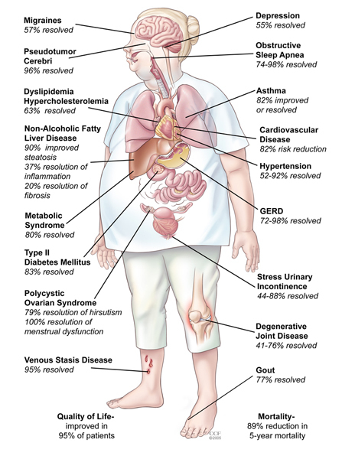

Slide 24
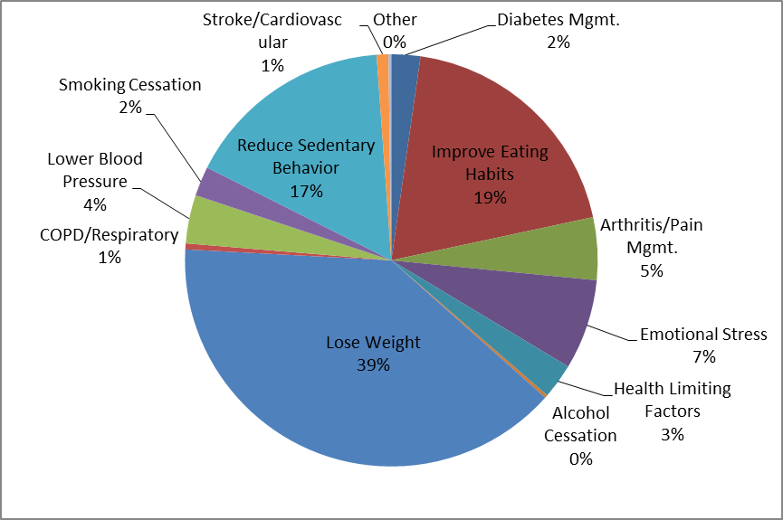
Wellness account spending by wellness goal

Slide 25
Progress to Date
Intervention Reported Relative to Control
Significant:
Decline in use of tobacco products
Improvement in reported mental status, lowered health risk due to improved mental status
Lowered use of alcohol among those reporting serious issues at baseline
Increased physical activity
Too early to determine if project will impact health expenditures / utilization / biometrics

Slide 26
Jean at baseline
Depression
Anxious, lonely
Emotional stress
“I don’t know why I’m even trying.”
Obese
Chronic knee pain
High blood pressure

Slide 27
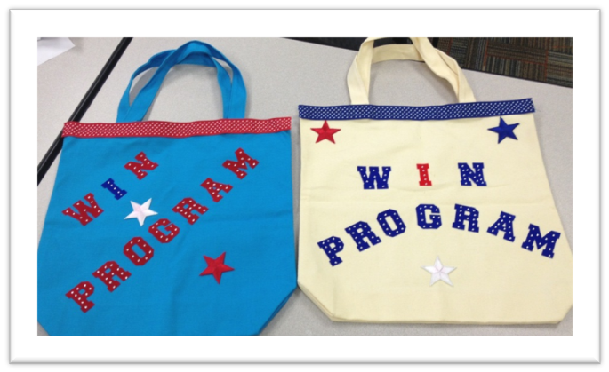
First Year - Jean
Strategies:
Positive motivation
Healthy diet
Exercise videos
Crafting supplies
Weight loss - 30 lbs.
BMI Change (baseline: 30 /1 Year: 25)
No longer takes medication for knee pain

Slide 28

Next Steps
28
WIN Study continues through December 2015 Final Report to CMS, April 2016
SDC findings are informing plans for extension of the Dallas Pilot
Developing plans with Medicaid Office and stakeholders for a potential SDC Pilot in the state’s fully integrated managed care model. Pilot could implement in 2016.

Slide 29
Acknowledgements
The WIN project is supported by Funding Opportunity Number CMS-1B1-11-001 from the U.S Department of Health and Human Services, Centers for Medicare & Medicaid Services. The contents provided are solely the responsibility of the authors and do not necessarily represent the official views of HHS or any of its agencies.
SDC project data derived from analysis performed by the University of Illinois at Chicago, Judith Cook, PhD, Principle Investigator. Investigation funded by NIDRR & SAMHSA, No. H133B100028
WIN project data derived from analysis performed by the University of Florida, Gainesville, Elizabeth Shenkman PhD, Principle Investigator.

