Slide 1
Peer-Delivered Health Promotion Models & Research Evidence
Judith A. Cook, Ph.D.
Professor and Director
Center on Mental Health Services Research & Policy
Department of Psychiatry
University of Illinois at Chicago
Presented at Fogarty UIC Global Mental Health & Migration Research & Training Program
Chicago, IL, March 12, 2015

Slide 2
What is a MH Peer?
A person who…
has experienced mental illness
has receive MH services
is in recovery & functioning well enough to assist others
is willing to disclose their mental health problems publicly in order to assist others

Slide 3
Why Peer Services?
From Pillars of Peer Support (Daniels et al., 2010)
Key characteristics differentiating peer specialist services from traditional clinical services
peers operate on the basis of lived experience as well as training
draw on their experiential knowledge to build supportive relationships with service recipients
uniquely qualified to help others formulate goals and objectives for recovery
http://www.pillarsofpeersupport.org/

Slide 4
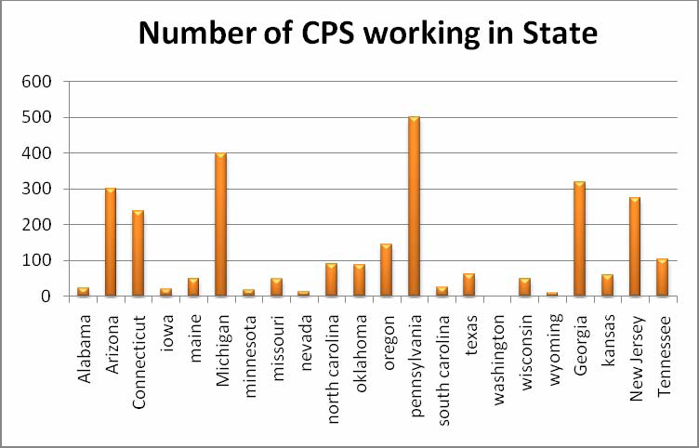
in 22 states with a peer workforce
Pillars of Peer Support, Daniels et al, 2010

Slide 5
States with Peer Workforces
most states have a distinct CPS service code to bill the government for peer specialist services
all states have minimum number of training hours required for certification (40-80 hours)
15 of the 17 states have a state certification process for peer specialists
most common certifying organization is the state mental health authority
From Pillars of Peer Support, 2010

Slide 6
Peer-Provided Health & MH Promotion Models*
  Self-help/mutual support groups (Recovery, GROW, Depression & Bipolar Support Alliance, Schizophrenics Anonymous)
  Peer-to-peer education (BRIDGES, Illness Management & Recovery)
  Recovery & wellness self-management (WRAP, Taking Charge)
  Peer addiction recovery services (AA, Double Trouble)
  Employment of peers in programs using established clinical models (ACT, ICM, Supported Employment)
  Research-based peer services: supported socialization (Davidson et al. 2006), consumer advocacy (O’Donnell, 1999), case management (Sells et al., 2006), HARP (Druss et al., 2010), Living Well (Goldberg et al., 2013)
* Partial list

Slide 7

Type of Evidence Supporting an Intervention Determines its “Grade”

Slide 8
US Agency for Healthcare Policy & Research
Evidence Rating Guidelines
Level Ia evidence from meta-analysis of multiple randomized controlled trials (RCT)
Level Ib evidence from at least 1 RCT
Level IIa at least one well-designed controlled study without randomization
Level IIb evidence from at least 1 non-controlled, well- designed quasi-experimental study
Level III evidence obtained from well-designed non- experimental descriptive studies, such as comparative studies, correlation studies, & case studies
Level IV expert committee reports or opinions &/or clinical experiences of respected authorities

Slide 9
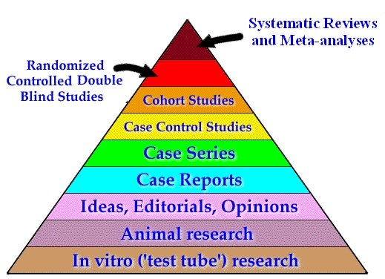
The Level of Evidence Supporting an Intervention Determines Whether it is an Evidence-Based Practice
Guide to Research Methods-The Evidence Pyramid; http://servers.medlib.hscbklyn..edu/2100.htm

Slide 10
Wellness Recovery Action Plan (WRAP)
Physical & MH self-management model
  Randomized controlled trials of 8-week WRAP intervention compared to services as usual
  Compared to controls, participants had: 1) significantly lower psychiatric symptom severity maintained throughout 6-month follow-up; 2) greater increases in hopefulness & self-assessed recovery, 3) enhanced empowerment, 4) higher quality of life, 5) higher patient self-advocacy, & 6) lower formal service use (Cook et al., 2011, 2012, 2014)
    WRAP Evidence Grade - Level Ib*
    *Level Ib - evidence from at least 1 randomized controlled trial, U.S. Agency for Healthcare Research & Quality 1992 Evidence Rating Guidelines

Slide 11
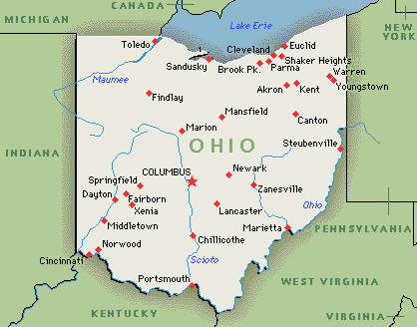
Toledo
Lorain
WRAP
STUDY
SITES
Cleveland
Canton
Dayton
Columbus

Slide 12

Peer Facilitators in the Ohio WRAP Study

Slide 13
WRAP
Session 1: Wellness Toolbox. Personalized wellness strategies.
Session 2: Daily maintenance plan. Things to do every day to maintain wellnesss.
Session 3: Triggers. ID external events or circumstances that produce discomfort, these are normal reactions but they signal the need to take action
Session 5: Early warning signs and how these signal a need for additional support
Session 6-7: When things are breaking down. Create crisis plan with individuals willing to help & types of assistance preferred.
Session 8: Plan for post-crisis support & retooling WRAP plan after a crisis to avoid relapse. Graduation ceremony

Slide 14
WRAP Active Therapeutic Ingredients
Role modeling & rehearsal
Social support from peers & others
Cognitive behavioral therapy
Self-esteem enhancement
Advance crisis planning
Development of coping mastery
Illness self-management

Slide 15
Living Well
Health promotion group developed for research study
  Randomized controlled trial of 13-session group compared to services as usual
  At 2-month follow-up, compared to controls, Living Well participants reported significant improvements in health self-management behaviors, health locus of control, healthy eating, & physical activity (Goldberg et al., 2013).
    Living Well Evidence Grade - Level Ib*
  *Level Ib - evidence from at least 1 randomized controlled trial, U.S. Agency for Healthcare Research & Quality 1992 Evidence Rating Guidelines

Slide 16
Health and Recovery Peer Program (HARP)
Health promotion model developed for research study
  Randomized controlled trial of 6-week HARP group sessions compared to services as usual
  At 6-month follow-up, compared to controls, HARP participants reported significant improvements in physical activity, # visits to primary care doctors, medication adherence, physical health- related quality of life, and perceived ability to manage one’s illness and health behaviors (Druss et al., 2010).
    HARP Evidence Grade - Level Ib*
  *Level Ib - evidence from at least 1 randomized controlled trial, U.S. Agency for Healthcare Research & Quality 1992 Evidence Rating Guidelines
Notes:
The level of evidence for Mental illness self-management models such as Wellness Recovery Action Planning or WRAP, is at Level IIb, evidence obtained from several non-controlled, well-designed quasi-experimental study.

Slide 17
Peer Case Management Services
(Peer staff deliver traditional clinical services)
  3-arm RCT comparing Assertive Community Treatment (ACT) from peers, non-peer ACT, & services as usual (Clarke et al., 2000) found peer ACT recipients had fewer hospitalizations & longer community tenure
  RCT of Intensive Case Management (Solomon & Draine, 1999) from peers vs. non-peers found no significant outcome differences
  Peer Case Management Evidence Grade - Level Ib*
  *Level Ib - evidence from at least 1 randomized controlled trial, U.S. Agency for Healthcare Research & Quality 1992 Evidence Rating Guidelines

Slide 18
Additional Studies
O’Donnell et al. (1999) 3-arm RCT compared 1) client focused case management (CFCM), 2) CGCM + advocacy, and 3) standard CM. Not all advocates were consumers, advocacy not described in detail, and no fidelity reported. No differences in participant outcomes.
Sells et al. (2006) RCT compared “broad based” case management (no model specified or fidelity reported) from peer providers vs. non peer providers. Participants reported higher positive regard from peer CMs than non-peers at 6 but not 12 months.
Davidson et al. (2004) 3-arm RCT compared 1) $ stipend only, 2) $ + supported socialization (SS) with peer, 2) $ + SS with non-peer. SS fidelity not reported. Found no differences between conditions.

Slide 19
Conclusions
When interventions are well-defined models (WRAP, HARP, Living Well) & peers achieve high model fidelity, outcomes are superior to outcomes of Ss receiving services as usual.
Outcomes of Ss receiving loosely defined peer services (supported socialization, consumer advocacy, borad-based case management) without fidelity monitoring tend be no different than non-peer services or services as usual.

Slide 20
Conclusions (cont.)
States’ peer workforces are sizable and should be viewed as distinct workforce entities with their own needs and strengths.
Need for workforce analysis & initiatives to support peer service provider training and growth.
Peer workforces exist at multiple levels in multiple contexts e.g., within managed care organizations, individual service provider agencies, as independent entities.

Slide 21
For further information
UIC Center website…
http://ww.psych.uic.edu/uicnrtc
Pillars of Peer Support website…
http://www.pillarsofpeersupport.org/

